Slide 1

Data Engineering Capstone — D610

Slide 2
Introduction
Name: Hiyab Mengisteab
Education: Bachelor of Business Administration; Currently completing a Master’s in Data Analytics -Data Engineering
Experience: 7 years of experience as a Business and Data Analyst
Study Objective: To identify and understand the key factors influencing daily sales

Slide 3
Overview
This research project focuses on developing a predictive model that leverages environmental and demographic factors—such as weather, location, and population—to estimate restaurant sales in dollar amounts. The goal is to support improved inventory planning and enable data-driven decision-making.
Methodology: Multiple Linear Regression applied to the X Restaurant Sales Dataset
Purpose: Create an accurate predictive model for restaurant sales
Hypothesis:
H₀: A predictive MLR model cannot be developed from the dataset
H₁: A predictive MLR model can be constructed from the dataset with a model accuracy exceeding 70%

Slide 4
Data Collection
Sources of data:
Private business owner: X Restaurant daily sales dataset
Public sources: Meteostat API (weather data) and city-level population statistics
Dataset scope:
8,830 daily records
Covers sales, location, and weather variables
Timeframe: January 2023 – June 2025
Advantages of this approach:
Combines real-world business data with reliable external environmental information
Enables a richer and more accurate predictive model
Challenges:
Multiple data sources led to missing or misaligned records (differences in date formats, station coverage)
Solutions:
Data cleaning and transformation:
Standardized dates
Imputed missing values
Verified consistency across sources
Result: High-quality dataset suitable for regression modeling

Slide 5
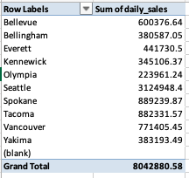
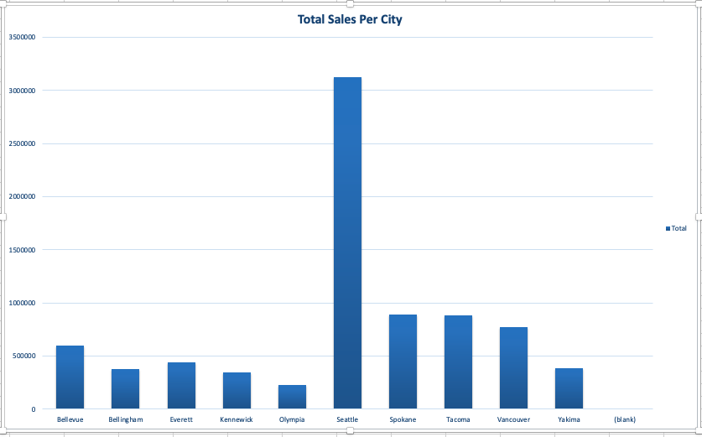

Slide 6
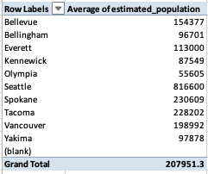
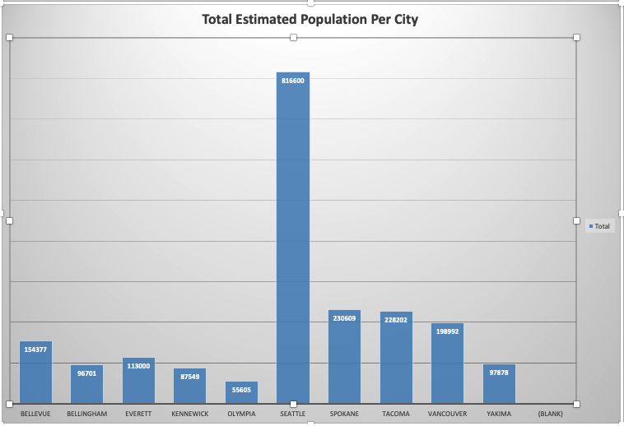

Slide 7
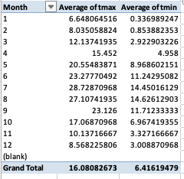
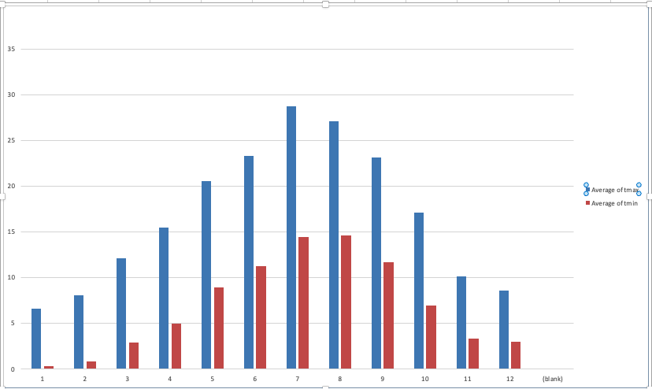

Slide 8
Data Analysis Process:
Data Preparation:
Standardized numerical variables and encoded categorical variables
One-hot encoding for city; label encoding for season
Exploratory Data Analysis:
Visualized relationships using Seaborn and Matplotlib scatterplots
Reviewed PCA variance ratios for dimensionality insights
Predictive Modeling:
Applied Linear Regression (scikit-learn)
Refined model using stepwise and backward elimination
Evaluated model with statsmodels (coefficients, R², adjusted R²)
Calculated Mean Squared Error (MSE) for training and test sets
Advantages:
Combines interpretability and predictive performance
Supports feature selection and robust model creation
Limitations:
Stepwise/backward elimination can be computationally intensive
May exclude variables with subtle but meaningful combined effects

Slide 9
Findings metrics
Findings from Data Analysis:
Model Performance:
Multiple Linear Regression explains ~73% of variance in daily sales
R² = 0.734; Adjusted R² = 0.733
Key Predictors:
Significant variables (p < 0.01): minimum & maximum temperature, season, day of year, city
Geographic differences:
Seattle → highest positive impact on sales
Olympia & Kennewick → negative impact relative to baseline
Model Accuracy:
Training MSE: 324,996.20
Test MSE: 345,751.92
Close MSE values indicate good generalization; minimal overfitting
Insight: Environmental and geographic factors strongly influence daily restaurant sales

Slide 10
Linear Regression Equation
Based on the finding with backward elimination, the following variables showed the most impactful for the linear equation
The estimated multiple linear regression equation based on the provided coefficients is:
daily_sales =121.0128 +(16.1303⋅tmin) + (5.3713⋅tmax) + (169.8779⋅season) − (0.2216⋅day_of_year) − (221.6950⋅city_Bellingham) − (202.3155⋅city_Everett) − (273.3071⋅city_Kennewick) − (381.5486⋅city_Olympia) + (2861.6048⋅city_Seattle) + (353.7104⋅city_Spokane) + (312.6293⋅city_Tacoma) + (184.2181⋅city_Vancouver) − (193.8709⋅city_Yakima)
Variable | Coefficient
Intercept | 121.0128
tmin | 16.1303
tmax | 5.3713
season | 169.8779
day_of_year | -0.2216
city_Bellingham | -221.6950
city_Everett | -202.3155
city_Kennewick | -273.3071
city_Olympia | -381.5486
city_Seattle | 2861.6048
city_Spokane | 353.7104
city_Tacoma | 312.6293
city_Vancouver | 184.2181
city_Yakima | -193.8709

Slide 11
Limitations and Future Enhancement
Limitations and Recommendations:
Limitations:
Model assumes linear relationships; may not capture non-linear effects or interactions
Practical Actions:
Prioritize staffing and inventory for high-demand cities and peak seasons
Adjust strategies based on predicted sales trends influenced by weather and seasonality
Future Improvements:
Incorporate promotional, holiday, and event-based data to improve accuracy
Explore non-linear or machine learning models (e.g., Random Forest, Gradient Boosting) to capture complex interactions and enhance predictive performance

